Slide 1
Early detection of Mental Health Conditions from Social Media
For 17-737 AI for Social Good at CMU
Professor Fei Fang
By Ashutosh Baghel, Alina Rath, Yue Zhang

Slide 2
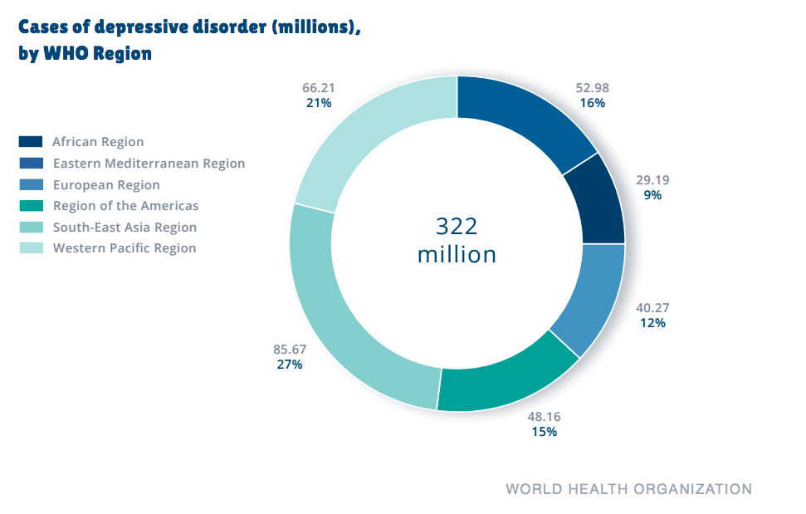
Motivation
Depressed individuals commonly turn to social media and other online forums for support before medical professionals.
Self harm is closely related to depression and hence detection of depressed individuals is of paramount importance.
[Yates et al.]
WHO Report: 2015

Slide 3
Dataset and Domain Description
Data extracted from Reddit posts per user.
Contains 3073 diagnosed and 35,753 control users per training, validation and testing splits.
Total of 9210 diagnosed users 107,274 control users.
On average each user in the dataset has 969 posts (median 646). Mean post length is 148 tokens.
[https://georgetown-ir-lab.github.io/emnlp17-depression/]
Notes:
.

Slide 4
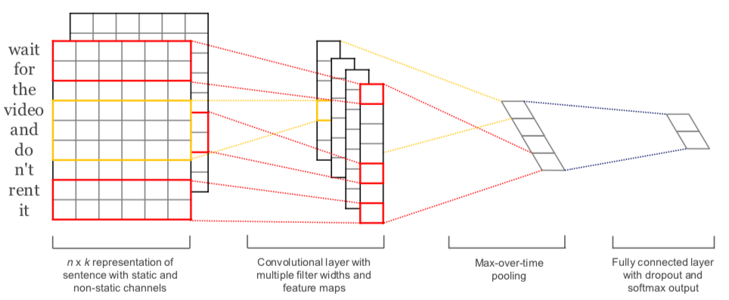
Related Work
Kim et al.’s CNN for sentence classification

Slide 5
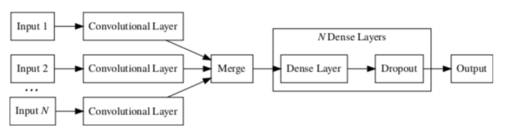
Related Work
Yates et al.’s CNN Model

Slide 6
Contribution
Phase 0: Reproduce original work by Yates et al.
Phase 1: Experiment different models for sentence feature extraction
MaxPooling1D (instead of average pooling of sentence features)
Hierarchical Convolutions (instead of pooling)
Multiple Filter-Window Size (as done by Kim et al.)
Recurrent NNs as feature extractors
Phase 2 (In-Progress) : Apply new techniques
Contextualized Word Embeddings for more meaningful representations.
Attention-based models instead of Convolutional or Recurrent NNs.

Slide 7
Evaluation/Results/Summary
Baseline Replication:
Max Pooling:
 | Precision | Recall | F-1 Score | Support
Depression | 0.52 | 0.50 | 0.51 | 3,070
Control | 0.96 | 0.96 | 0.96 | 35,775
 | Precision | Recall | F-1 Score | Support
Depression | 0.51 | 0.51 | 0.51 | 3,070
Control | 0.96 | 0.96 | 0.96 | 35,775

Slide 8
Future Work
Debiasing gender stereotypes in the data and word embeddings.
Feature engineer with Instagram image data, labels are learned from hashtags.
Data augmentation and formulation of a bigger dataset, vetted by medical experts that could be used to predict stages of mental health.
Building a network graph based on user interactions on social media platform to analyze influence on one another for better classification.
Incorporating cyberbullying analysis.

Slide 9
Q&A

